Slide 1
Tutorial-3
Prob1: Express F=A+B’C in canonical forms SOP and POS.
Prob2: A[B+C(AB+AC)’] , no. of NAND gates required to design the logic ?
Prob3: Is (A ex-or B) ex-nor C = A ex-or(B ex-nor C)+(A ex-or A) ?
Prob4: (A’+B).(A+B)= ?
Prob5: Simplify the following Boolean function:
F(A,B,C,D)= π(0,1,5,7,8,9,15) and F(A,B,C,D)=Σ(2,3,4,6,11,12)
here don’t care set is (10,13,14),name the essential or non-essential prime implicants and find minimized expression.
Prob6: Simplify F=A+A’B+A’B’C+A’B’C’D+A’B’C’D’E

Slide 2
SOP form →F=(A+B’C)
=A(B+B’)+B’C(A+A’) → [expanded using A and B terms]
=AB+AB’+AB’C+A’B’C
=AB(C+C’)+AB’(C+C’) +AB’C+A’B’C[expanded using C terms]
=ABC+ABC’+AB’C+AB’C’+AB’C+A’B’C
=ABC +ABC’+AB’C+AB’C’+A’B’C
And ABC=111=m7, ABC’=110=m6, AB’C= 101=m5, AB’C’=100=m4, A’B’C=001=m1
=Σ(1,4,5,6,7)
POS form →F=(A+B’C)
=(A+B’).(A+C) →By using distributive law
=(A+B’+CC’).(A+C+BB’) → [expanded using B and C terms]
=(A+B’+C).(A+B’+C’).(A+C+B).(A+C+B’) →By using distributive law
=(A+B’+C).(A+B’+C’).(A+C+B)
And
=A+B’+C=010=M2
=A+B’+C’=011=M3
=A+B+C=000=M0
=π(0,2,3)

Slide 3
No. of NAND gates required A[B+C(AB+AC)’]
=A[B+C{(AB)’.(AC)’}] →d’morgen’law
=A[B+C(A’+B’).(A’+C’)] → d’morgen’law
=A[B+C(A’A’+A’C’+A’B’+B’C’)]
=A[B+C(A’+A’C’+A’B’+B’C’)]
= A[B+C(A’(1+C’+B’)+B’C’)]
= A[B+C(A’+B’C’)]
=A[B+A’C+0]
=AB+0=A.B

Slide 4
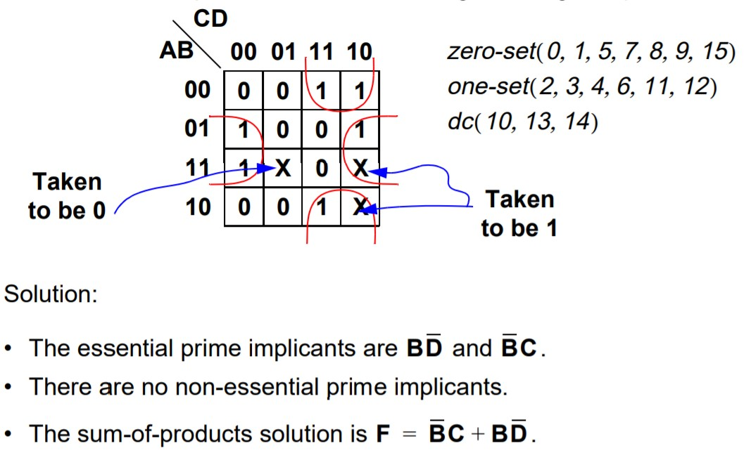

Slide 5
